Slide 1
MIS 7720 #11 Recurrent Neural Networks (RNN) & Long Short-Term Memory (LSTM)

Slide 2
Why RNN?
The limitations of the Convolutional Neural Networks
Take fixed length vectors as input and produce fixed length vectors as output.
Allow fixed amount of computational steps.
We need to model the data with temporal or sequential structures and varying length of inputs and outputs
Example:
This movie is ridiculously good.
This movie is very slow in the beginning but picks up pace later on and has some great action sequences and comedy scenes.

Slide 3
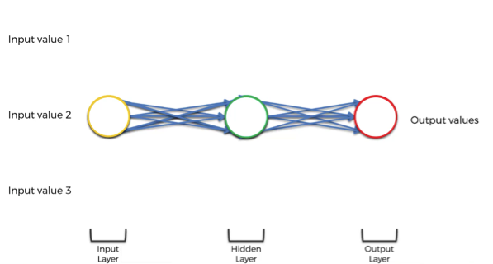
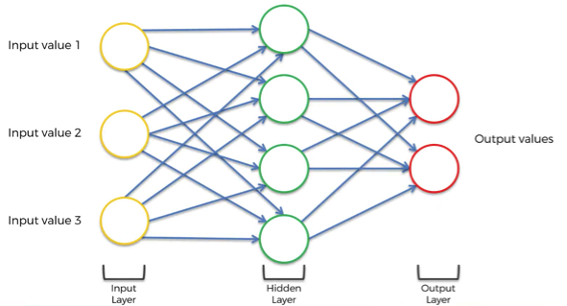
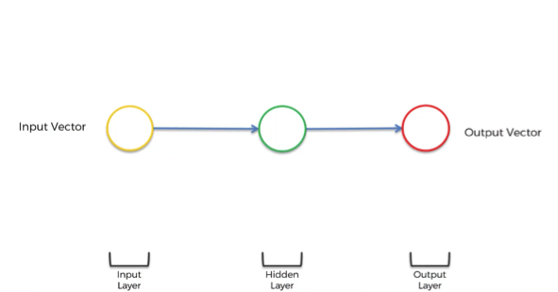
RNN representation

Slide 4
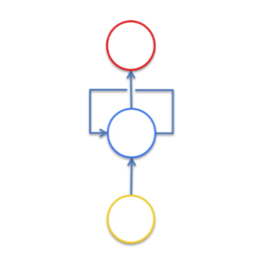
What is RNN?
Recurrent neural networks are connectionist models with the ability to selectively pass information across sequence steps, while processing sequential data one element at a time.
Allows a memory of the previous inputs to persist in the model’s internal state and influence the outcome.
OUTPUT
h(t)
h(t)
Hidden Layer
Delay
h(t-1)
x(t)
INPUT
Notes:
Article: https://towardsdatascience.com/illustrated-guide-to-recurrent-neural-networks-79e5eb8049c9
Video: https://www.youtube.com/watch?v=LHXXI4-IEns

Slide 5
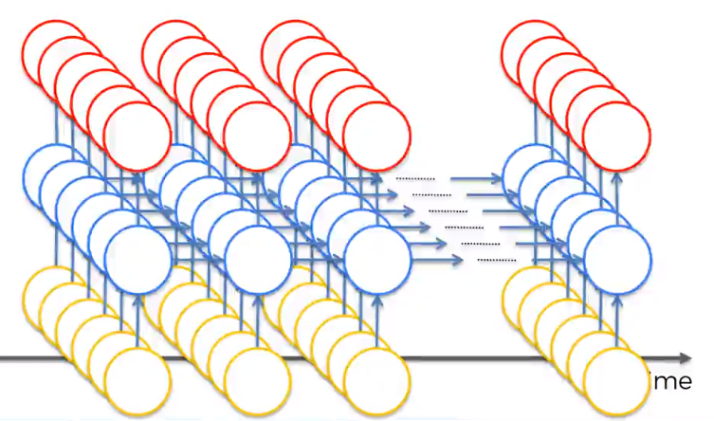
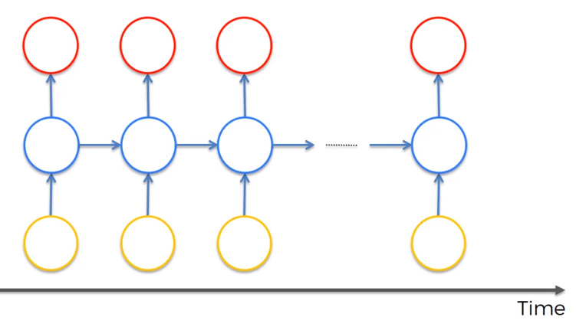
RNN representation
Unroll temporal loop

Slide 6
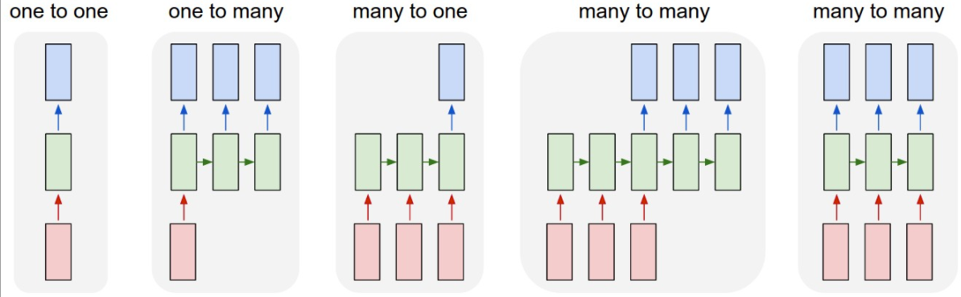
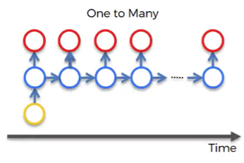

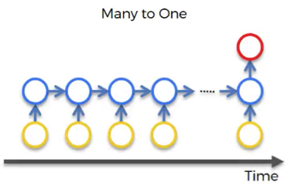
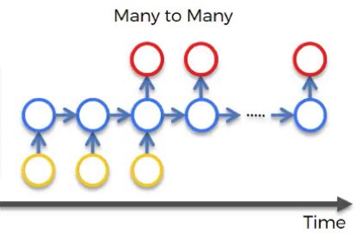
Examples of RNN application
A person riding a motorbike on dirt road
Image Captioning
Positive
Thanks for the great tutorial.
Sentiment Analysis
Happy
Machine Translation
Diwali
शुभ
दीपावली
Notes:
An image (input), which is described by a computer with words (outputs). The image first went through CNN and then was fed into RNN. While CNN is responsible here for image processing and feature recognition, our RNN allows the computer to make sense out of the sentence.
You have lots of text, such as a customer’s comment, and you need to gauge what’s the chance that this comment is positive/negative, or how positive/negative this comment actually is.

Slide 7












RNN (rolled over time)
RNN is awesome
OUTPUT
$$w_{h}$$
$$w_{h}$$
$$w_{h}$$
$$w_{y}$$
h0
$f_{h}$()
h1
$f_{h}$()
h2
$f_{h}$()
h3
$f_{y}$()
$$w_{x}$$
$$w_{x}$$
$$w_{x}$$
x1
x2
x3
RNN
is
awesome
$$h\left(t\right)=f_{h}\left(w_{h}∗h\left(t−1\right)+w_{x}∗x\left(t\right)\right)$$

Slide 8














RNN (rolled over time)
RNN is so cool
$$w_{h}$$
$$w_{h}$$
$$w_{h}$$
$$w_{h}$$
$$w_{y}$$
h0
$f_{h}$()
h1
$f_{h}$()
h2
$f_{h}$()
h3
$f_{h}$()
h4
$f_{y}$()
$$w_{x}$$
$$w_{x}$$
$$w_{x}$$
$$w_{x}$$
x1
x2
x3
x4
OUTPUT
RNN
is
so
cool

Slide 9
The Vanishing Gradient Problem
RNN’s use back propagation.
Back propagation uses chain rule.
Chain rule multiplies derivatives
If these derivatives are between 0 and 1 the product vanishes as the chain gets longer.
or the product explodes if the derivatives are greater than 1.
Sigmoid activation function in RNN leads to this problem.
ReLu, in theory, avoids this problem but not in practice.
Notes:
Recall:
(stochastic) gradient descent algorithm finds the global minimum of the cost function.
Information travels through the neural network from input neurons to the output neurons, while the error is calculated and propagated back through the network to update the weights.
In RNN
information travels through time in RNNs, which means that information from previous time points is used as input for the next time points.
you can calculate the error (the cost function) at each time point.

Slide 10
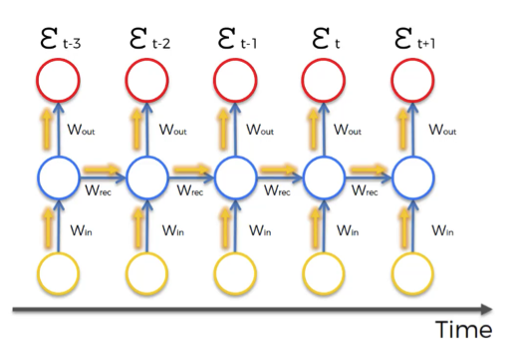
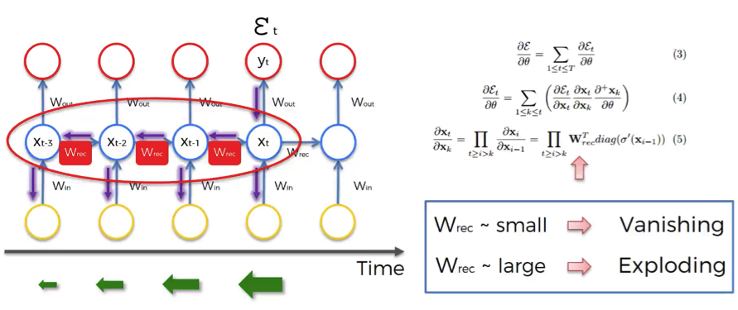
The Vanishing Gradient Problem
Notes:
Source: Razvan Pascanu et al. (2013)

Slide 11
Problem with vanishing gradient problem?
Doesn’t allow us to learn long term dependencies.
The lower the gradient is, the harder it is for the network to update the weights and the longer it takes to get to the final result.
The further you go through the network, the lower your gradient…
Solutions for exploding gradient
Stop backpropagating after a certain point (not optimal)
Penalize or artificially reduce gradient
Put a maximum limit on a gradient – gradient clipping
Solutions for vanishing gradient:
Initialize weights so that the potential for vanishing gradient is minimized;
Echo State Networks;
Long Short-Term Memory (LSTM)
Gated Recurrent Unit (GRU)
Notes:
The further you go through the network, the lower your gradient, which has a domino effect on all of the further weights in the network

Slide 12
Long Short Term Memory (LSTM)
LSTM provide solution to the vanishing/exploding gradient problem.
Solution: Memory Cell, which is updated at each step in the sequence.
Three Gates control the flow of information to and from the Memory cell
Input Gate: protect the current step from irrelevant inputs
Output Gate: prevents current step from passing irrelevant information to later steps.
Forget Gate: limits information passed from one cell to the next.
Notes:
Article: https://towardsdatascience.com/illustrated-guide-to-lstms-and-gru-s-a-step-by-step-explanation-44e9eb85bf21
Video: https://www.youtube.com/watch?v=8HyCNIVRbSU
For more details, see
https://colah.github.io/posts/2015-08-Understanding-LSTMs/

Slide 13





LSTM
c_: input from a memory cell
x_: input at time t
h_: output at time t
c0
Forget f1
+
c1
Input i1
$$w_{h}$$
$c_{1}$=$f_{1}$. $c_{0}$+$i_{i}$. $u_{1}$
h0
$f_{h}$()
h1
u1
$c_{t}$=$f_{t}$. $c_{t−1}$+$i_{t}$. $u_{t}$
$$w_{x}$$
x1

Slide 14





LSTM
c0
Forget f1
+
Forget f1
c1
$$w_{hf}$$
$f_{f}$()
Input i1
$$w_{h}$$
$f_{1}$=$f_{f}\left(W_{hf}∗h_{0}+W_{xf}∗x_{1}\right)$
h0
h0
$f_{h}$()
h1
u1
$$w_{x}$$
$f_{t}$=$f_{f}\left(W_{hf}∗h_{t−1}+W_{xf}∗x_{t}\right)$
$$w_{xf}$$
x1
x1

Slide 15





LSTM
c0
Forget f1
+
c1
$$w_{hi}$$
$f_{i}$()
Input i1
Input i1
$$w_{h}$$
$i_{1}$=$f_{i}\left(W_{hi}∗h_{0}+W_{xi}∗x_{1}\right)$
h0
h0
$f_{h}$()
h1
u1
$$w_{x}$$
$i_{t}$=$f_{f}\left(W_{hi}∗h_{t−1}+W_{xi}∗x_{t}\right)$
$$w_{xi}$$
x1
x1

Slide 16






LSTM
$o_{t}$=$f_{o}\left(W_{ho}∗h_{t−1}+W_{xo}∗x_{t}\right)$
$h_{t}$=$o_{t}.tanh\left(c_{t}\right)$
c0
Forget f1
+
c1
Input i1
$f_{o}$()
$$w_{h}$$
h0
$f_{h}$()
h1
Output o1
h1
u1
$$w_{x}$$
$$w_{h}$$
x1
h0
$f_{h}$()
h1
$$w_{x}$$
x1

Slide 17


LSTM
c0
Forget f1
+
c1
Forget f2
+
c2
Input i1
$f_{o}$()
Input i2
$f_{o}$()
$$w_{h}$$
$$w_{h}$$
h0
$f_{h}$()
u1
Output o1
h1
$f_{h}$()
u2
Output o2
h2
$$w_{x}$$
$$w_{x}$$
x1
x2

Slide 18
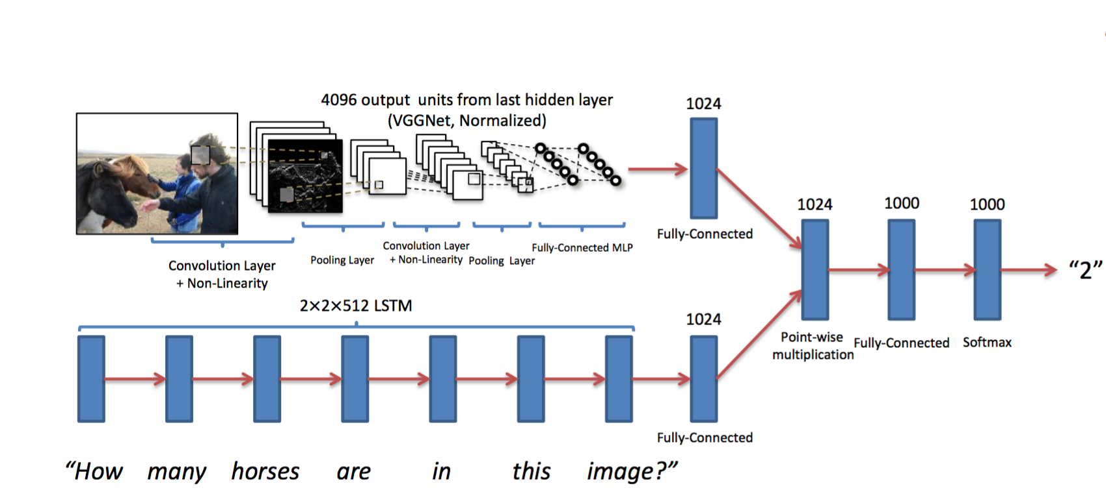
Example: Combining CNN and LSTM
Visual Question Answering

Slide 19
Takeaways
We don’t want the NN to forget what it learned from the previous input (e.g., one row of our data)
RNN+LSTM/GRU allows to selectively include what has been learned from prior observations together with the current input
Another article with more details and examples
http://karpathy.github.io/2015/05/21/rnn-effectiveness/

